Slide 1
Project Management Plan and Project Scope
DHS 413
Dr. Emmanuel Ehimen Okoh

Slide 2
Introduction
A Project Management Plan (PMP) is a formally approved document that defines how a project is executed, monitored, controlled, and closed.
The Project Management Plan integrates subsidiary management plans and baselines into a single, coherent document.
It serves as the primary reference point for decision-making throughout the project life cycle.

Slide 3
Purpose of the Project Management Plan
The key purposes of the Project Management Plan are to:
Provide a unified and approved roadmap for managing the project
Establish performance baselines for scope, schedule, and cost
Define management approaches for handling risks, changes, and resources
Serve as a communication and control tool for stakeholders
Support integration across all project management knowledge areas

Slide 4
Purpose of Key Components of a Project Management Plan
The Project Management Plan is composed of subsidiary plans and baselines.
Among the most critical components are the scope, schedule, budget (cost), and risk management plans.

Slide 5
a. Scope Management Component
The scope component defines what work is included and excluded from the project.
Its purpose is to: - Prevent scope creep by clearly defining project boundaries
- Ensure alignment between stakeholder expectations and deliverables
- Provide a basis for developing the Work Breakdown Structure (WBS)
A clearly defined scope ensures that project resources are focused only on authorized work.

Slide 6
b. Schedule Management Component
The schedule component establishes how and when project activities will be performed. Its purpose is to:
- Translate scope into time-bound activities
- Define milestones and critical paths
- Enable progress tracking and schedule control
The schedule serves as a time-based performance baseline against which actual progress is measured.

Slide 7
c. Budget (Cost) Management Component
The budget component defines how project costs are estimated, funded, managed, and controlled. Its purpose is to:
- Establish a cost baseline for performance measurement
- Ensure financial feasibility and accountability
- Support earned value and cost control analysis
The budget reflects the financial expression of the approved project scope.

Slide 8
d. Risk Management Component
The risk management component outlines how project risks are identified, analyzed, and addressed.
Its purpose is to:
- Anticipate uncertainties that may affect project objectives
- Reduce negative impacts and enhance positive opportunities
- Support proactive rather than reactive project control
Effective risk planning improves decision quality and project resilience.

Slide 9
Worked Example: Project Management Plan Components
Scenario: A university is implementing a new Learning Management System (LMS). - Scope: Configure LMS, migrate existing courses, train staff and students
- Schedule: 6-month implementation with milestones for configuration, testing, and rollout
- Budget: Includes software licensing, consultant fees, training costs
- Risk: Resistance to change, data migration errors, schedule delays
This example demonstrates how each PMP component guides decision-making and control.

Slide 10
Interdependency of Scope, Schedule, and Budget
Scope, schedule, and budget form the core constraints of project management, often referred to as the “triple constraint.”
These elements are highly interdependent:
Scope defines the work that must be completed
Schedule defines the time required to complete the work
Budget defines the cost of completing the work within the given time frame

Slide 11
Nature of the Interdependency
An increase in scope typically leads to longer schedules and higher costs
A compressed schedule often increases costs due to overtime or additional resources
Budget constraints may require scope reduction or schedule extensions
Changes to one constraint almost always require adjustments to the others.
Managing this interdependency is a key responsibility of the project manager and a central function of integrated change control.

Slide 12
Concept of Project Scope

Slide 13
Introduction to Project Scope
Project scope refers to the totality of work required to deliver a product, service, or result with specified features and functions.
At an advanced level, scope is understood as both a technical and managerial construct that defines project boundaries and success criteria.
Project scope answers the question: What work must be done to successfully complete the project?

Slide 14
Common Terminology Related to Project Scope

Slide 15
a. Scope Statement
A scope statement is a formal description of the project deliverables and the work required to create them.
It typically includes:
- Product scope description - Major deliverables - Acceptance criteria - Exclusions - Constraints and assumptions
The scope statement provides a shared understanding of project objectives among stakeholders.

Slide 16
b. In Scope
“In scope” refers to all work, deliverables, and activities that are explicitly included in the project scope statement. Only in-scope work is authorized for execution and funding.

Slide 17
c. Out of Scope
“Out of scope” refers to work or deliverables that are explicitly excluded from the project.
Clearly identifying out-of-scope items helps manage stakeholder expectations and reduces the risk of unauthorized work.

Slide 18
Concept of a Work Breakdown Structure (WBS)

Slide 19
Definition
A Work Breakdown Structure (WBS) is a hierarchical decomposition of the total project scope into smaller, more manageable components called work packages.

Slide 20
Purpose of the WBS
The WBS serves several critical purposes:
- Translates scope into manageable units of work
- Provides a foundation for scheduling, cost estimating, and resource planning
- Enhances scope clarity and accountability
- Supports performance measurement and control

Slide 21
Structure and Characteristics
The top level represents the overall project deliverable
Lower levels represent progressively detailed components
Work packages are the lowest level and can be scheduled, cost-estimated, and assigned

Slide 22
Structure and Characteristics
The top level represents the overall project deliverable
Lower levels represent progressively detailed components
Work packages are the lowest level and can be scheduled, cost-estimated, and assigned

Slide 23
Types of WBS
There are two types of WBS:
1) Deliverable-Based and
2) Phase-Based
The most common and preferred approach is the Deliverable-Based approach.
The main difference between the two approaches are the Elements identified in the first Level of the WBS.

Slide 24
Types of WBS
There are two types of WBS:
1) Deliverable-Based and
2) Phase-Based
The most common and preferred approach is the Deliverable-Based approach.
The main difference between the two approaches are the Elements identified in the first Level of the WBS.

Slide 25
Deliverable-Based Work Breakdown Structure
A Deliverable-Based Work Breakdown Structure clearly demonstrates the relationship between the project deliverables (i.e., products, services or results) and the scope (i.e., work to be executed).
Figure 1 is an example of a Deliverable-Based WBS for building a house.

Slide 26
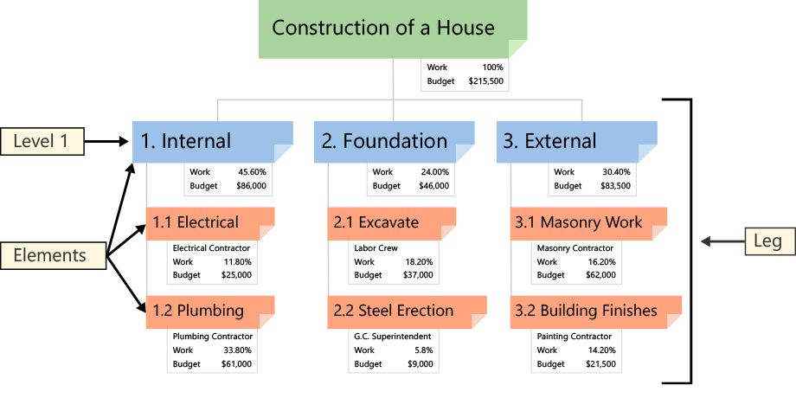
Deliverable-Based Work Breakdown Structure

Slide 27
Phase-Based Work Breakdown Structure
In Figure 2, a Phase-Based WBS, the Level 1 has five Elements.
Each of these Elements are typical phases of a project.
The Level 2 Elements are the unique deliverables in each phase.
Regardless of the type of WBS, the lower Level Elements are all deliverables.
Notice that Elements in different Legs have the same name.
A Phase-Based WBS requires work associated with multiple elements be divided into the work unique to each Level 1 Element.

Slide 28
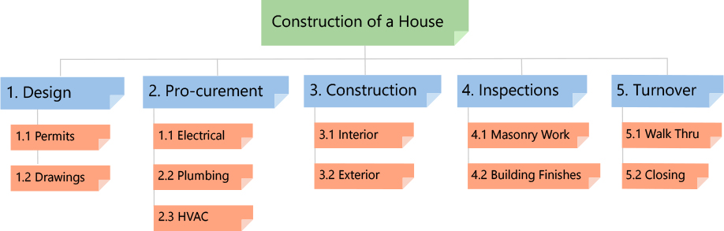
Phase-Based Work Breakdown Structure

Slide 29
QUESTION
Which of the following best describes the primary purpose of a WBS? A. To list project activities in sequence
B. To decompose project scope into manageable deliverables
C. To estimate project duration
D. To allocate the project budget

Slide 30
QUESTION
Which of the following best describes the primary purpose of a WBS? A. To list project activities in sequence
B. To decompose project scope into manageable deliverables
C. To estimate project duration
D. To allocate the project budget
Correct Answer: B

Slide 31
DISCUSSION QUESTIONS
Why is the Project Management Plan considered an integration document rather than a standalone plan?
Discuss how poor scope definition can negatively affect both schedule and budget.
In what ways does the WBS support risk identification and cost estimation?
How can clearly defined out-of-scope items reduce stakeholder conflict?

Slide 32
SUMMARY
The Project Management Plan provides an integrated framework for managing complex projects.
Understanding the purpose and interdependency of its components—particularly scope, schedule, and budget—is essential for effective project control.
Project scope, when properly defined and decomposed through a Work Breakdown Structure, forms the foundation upon which all other planning and execution activities are built.

Slide 33
THANK YOU

